Slide 1



Hadoop HDFS

Slide 2
Course Topics
Module 1
Module 5
Understanding Big Data
Hadoop Architecture
Analytics Using Hive
Understanding HIVE QL
Module 2
Module 6
Hadoop Cluster Configuration
Data Loading Techniques
Hadoop Project Environment
Advance Hive
NoSQL Databases and HBASE
Module 7
Module 3
Advance HBASE
Zookeeper Service
Hadoop MapReduce Framework
Programming in Map Reduce
Advance MapReduce
Module 8
Hadoop 2.0 – New Features
Programming in MRv2
Module 4
Analytics Using Pig
Understanding Pig Latin
Module 9
Project Discussion

Slide 3
Topics of the Day
What is Big Data?
Limitations of the existing solutions
Solving the problem with Hadoop
Introduction to Hadoop
Hadoop Eco-System
Hadoop Core Components
HDFS Architecture
Anatomy of a File Write and Read

Slide 4







What is Big Data?
Lots of Data (Terabytes or Petabytes)
Big data is the term for a collection of data sets so large and complex that it becomes difficult to process using on-hand database management tools or traditional data processing applications.
The challenges include capture, curation, storage, search, sharing, transfer, analysis, and visualization.
support
database
cloud
storage
tools
statistics
analyze
Big Data
information
No SQL
compression
mobile
processing
terabytes

Slide 5

What is Big Data?
Systems / Enterprises generate huge amount of data from Terabytes to and even Petabytes of information.
NYSE generates about one terabyte of new trade data per day to perform stock trading analytics to determine trends for optimal trades.

Slide 6
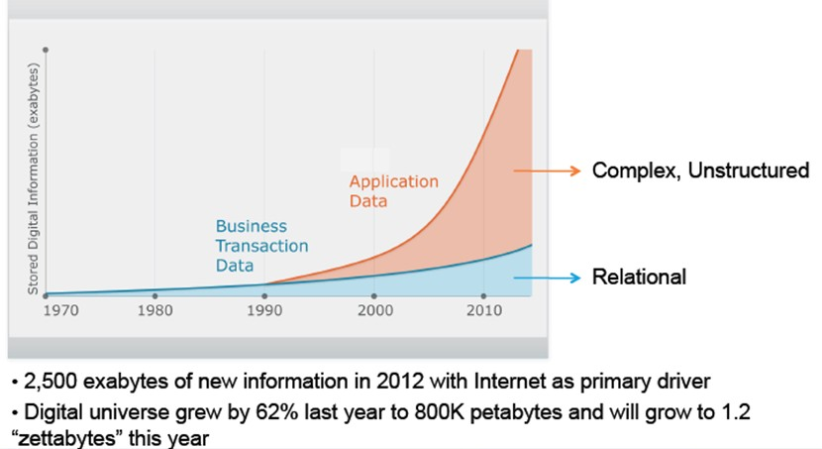
Un – Structured Data is Exploding

Slide 7














IBM’s Definition
IBM’s Definition – Big Data Characteristics
http://www-01.ibm.com/software/data/bigdata/
Web logs
Videos
Audios
Images
Sensor Data
Volume
Velocity
Variety

Slide 8


Common Big Data Customer Scenarios
Web and e-tailing
Recommendation Engines
Ad Targeting
Search Quality
Abuse and Click Fraud Detection
Telecommunications
Customer Churn Prevention
Network Performance Optimization
Calling Data Record (CDR) Analysis
Analyzing Network to Predict Failure
http://wiki.apache.org/hadoop/PoweredBy

Slide 9

Common Big Data Customer Scenarios(Contd.)
Government
Fraud Detection and Cyber Security
Welfare Schemes
Justice
Healthcare & Life Sciences
Health Information Exchange
Gene Sequencing
Serialization
Healthcare Service Quality Improvements
Drug Safety
http://wiki.apache.org/hadoop/PoweredBy

Slide 10


Common Big Data Customer Scenarios Contd.)
Banks and Financial services
Modeling True Risk
Threat Analysis
Fraud Detection
Trade Surveillance
Credit Scoring and Analysis
Retail
Point of Sales Transaction Analysis
Customer Churn Analysis
Sentiment Analysis
http://wiki.apache.org/hadoop/PoweredBy

Slide 11







Hidden Treasure
Insight into data can provide Business Advantage.
Some key early indicators can mean Fortunes to Business.
More Precise Analysis with more data.
Case Study: Sears Holding Corporation
X
*Sears was using traditional systems such as Oracle Exadata, Teradata and SAS etc. to store and process the customer activity
and sales data.
Slide 17

Slide 12












Limitations of Existing Data Analytics Architecture
BI Reports + Interactive Apps
1. Can’t explore original high fidelity raw data
A meagre 10% of the
~2PB Data is available for BI
Processing
RDBMS (Aggregated Data)
ETL Compute Grid
90% of the ~2PB Archived
2. Moving data to compute doesn’t scale
Storage only Grid (original Raw Data)
3. Premature data
death
Storage
Mostly Append
Collection
Instrumentation
http://www.informationweek.com/it-leadership/why-sears-is-going-all-in-on-hadoop/d/d-id/1107038?

Slide 13









Solution: A Combined Storage Computer Layer
BI Reports + Interactive Apps
1. Data Exploration & Advanced analytics
RDBMS (Aggregated Data)
No Data Archiving
Entire ~2PB Data is available for processing
2. Scalable throughput for ETL &
aggregation
Hadoop : Storage + Compute Grid
3. Keep data alive forever
Mostly Append
Collection
Instrumentation
Both Storage And Processing
*Sears moved to a 300-Node Hadoop cluster to keep 100% of its data available for processing rather than a meagre 10% as was the case with existing Non-Hadoop solutions.

Slide 14




Hadoop Differentiating Factors
Accessible
Simple
Differentiating
Factors
Robust
Scalable

Slide 15
Hadoop – It’s about Scale and Structure
RDBMS
EDW
MPP
NoSQL
HADOOP
Structured | Data Types | Multi and Unstructured
Limited, No Data Processing | Processing | Processing coupled with Data
Standards & Structured | Governance | Loosely Structured
Required On write | Schema | Required On Read
Reads are Fast | Speed | Writes are Fast
Software License | Cost | Support Only
Known Entity | Resources | Growing, Complexities, Wide
Interactive OLAP Analytics Complex ACID Transactions Operational Data Store | Best Fit Use | Data Discovery Processing Unstructured Data Massive Storage/Processing

Slide 16




Why DFS?
Read 1 TB Data
1 Machine
4 I/O Channels
Each Channel – 100 MB/s
10 Machines
4 I/O Channels
Each Channel – 100 MB/s

Slide 17
Why DFS?
Read 1 TB Data
1 Machine
4 I/O Channels
Each Channel – 100 MB/s
10 Machines
4 I/O Channels
Each Channel – 100 MB/s
45 Minutes

Slide 18
Why DFS?
Read 1 TB Data
1 Machine
4 I/O Channels
Each Channel – 100 MB/s
10 Machines
4 I/O Channels
Each Channel – 100 MB/s
45 Minutes
4.5 Minutes

Slide 19

What is Hadoop?
Apache Hadoop is a framework that allows for the distributed processing of large data sets across clusters of commodity computers using a simple programming model.
It is an Open-source Data Management with scale-out storage & distributed processing.

Slide 20











Hadoop Eco-System
Apache Oozie (Workflow)
Hive
DW System
Pig Latin
Data Analysis
Mahout
Machine Learning
MapReduce Framework
HBase
HDFS (Hadoop Distributed File System)
Flume Sqoop
Import Or Export
Unstructured or
Semi-Structured data
Structured Data

Slide 21








Machine Learning with Mahout
Write intelligent applications using Apache Mahout
LinkedIn Recommendations
Hadoop and MapReduce magic in action
https://cwiki.apache.org/confluence/display/MAHOUT/Powered+By+Mahout

Slide 22













Hadoop Core Components
MapReduce Engine
Job Tracker
Task Tracker
Task Tracker
Task Tracker
Task Tracker
HDFS
Cluster
Admin Node
Name node
Data Node
Data Node
Data Node
Data Node

Slide 23
Hadoop Core Components
Hadoop is a system for large scale data processing.
It has two main components:
HDFS – Hadoop Distributed File System (Storage)
Distributed across “nodes”
Natively redundant
NameNode tracks locations.
MapReduce (Processing)
Splits a task across processors
“near” the data & assembles results
Self-Healing, High Bandwidth
Clustered storage
JobTracker manages the TaskTrackers

Slide 24
HDFS Definition
The Hadoop Distributed File System (HDFS) is a distributed file system designed to run on commodity hardware.
HDFS is a distributed, scalable, and portable filesystem written in Java for the Hadoop framework.
It has many similarities with existing distributed file systems.
Hadoop Distributed File System (HDFS™) is the primary storage system used by Hadoop applications.
HDFS creates multiple replicas of data blocks and distributes them on compute nodes throughout a cluster to enable reliable, extremely rapid computations.
HDFS is highly fault-tolerant and is designed to be deployed on low-cost hardware.
HDFS provides high throughput access to application data and is suitable for applications that have large data sets
HDFS consists of following components (daemons)
Name Node
Data Node
Secondary Name Node

Slide 25

HDFS Components
Namenode:
NameNode, a master server, manages the file system namespace and regulates access to files by clients.
Maintains and Manages the blocks which are present on the datanode.
Meta-data in Memory
– The entire metadata is in main memory
Types of Metadata
– List of files
– List of Blocks for each file
– List of DataNodes for each block
– File attributes, e.g creation time, replication factor
A Transaction Log
– Records file creations, file deletions. Etc

Slide 26



NameNode Metadata
Meta-data in Memory
The entire metadata is in main memory
No demand paging of FS meta-data
Types of Metadata
List of files
List of Blocks for each file
List of DataNode for each block
File attributes, e.g. access time, replication factor
A Transaction Log
Records file creations, file deletions. etc
NameNode (Stores metadata only)
METADATA:
/user/doug/hinfo -> 1 3 5
/user/doug/pdetail -> 4 2
NameNode:
Keeps track of overall file directory structure and the placement of Data Block

Slide 27

HDFS Components
Data Node: Slaves which are deployed on each mechine and provide the actual storage.
DataNodes, one per node in the cluster, manages storage attached to the nodes that they run on
A Block Server
– Stores data in the local file system (e.g. ext3)
– Stores meta-data of a block (e.g. CRC)
– Serves data and meta-data to Clients
– Block Report
– Periodically sends a report of all existing blocks to the NameNode
Facilitates Pipelining of Data
– Forwards data to other specified DataNodes

Slide 28















Secondary NameNode
metadata
Single Point Failure
NameNode
Secondary NameNode:
Not a hot standby for the NameNode
Connects to NameNode every hour*
Housekeeping, backup of NemeNode metadata
Saved metadata can build a failed NameNode
You give me metadata every hour, I will make it secure
Secondary NameNode
metadata

Slide 29
















HDFS Architecture
Metadata ops
NameNode
Metadata (Name, replicas,…):
/home/foo/data, 3,…
Client
Block ops
Read
DataNodes
DataNodes
Replication
Blocks
Write
Rack 1
Client
Rack 2

Slide 30









Anatomy of A File Write
2. Create
NameNode
HDFS
Client
1. Create
3. Write
Distributed File System
NameNode
7. Complete
6. Close
4. Write Packet
5. ack Packet
4
4
Pipeline of Data nodes
DataNode
DataNode
DataNode
DataNode
5
DataNode
5
DataNode

Slide 31



Anatomy of A File Read
1. Open
2. Get Block locations
Distributed File System
NameNode
HDFS
Client
3. Read
NameNode
6. Close
Client JVM
Client Node
FS Data Input Stream
4. Read
5. Read
DataNode
DataNode
DataNode
DataNode
DataNode
DataNode

Slide 32
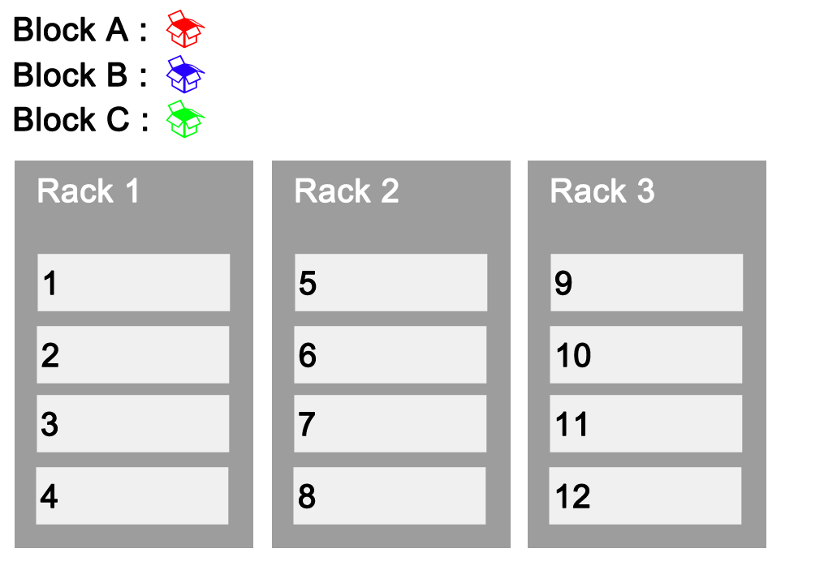




Replication and Rack Awareness

Slide 33
Pre-work
Setup the Hadoop development environment using the documents present in the LMS.
Hadoop Installation – Setup Cloudera CDH3 Demo VM
Execute Linux Basic Commands
Execute HDFS Hands On commands
Attempt the Module-1 Assignments present in the LMS.

Slide 34
Thank You
See You in Next Class

